Slide 1
DS3202: PARALLEL PROGRAMMING
MODULE – 5
Advanced CUDA Concepts
6th SEM
B.Tech
DSE

Slide 2
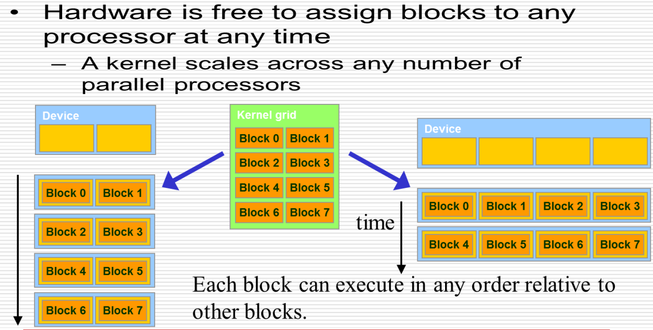
Transparent Scalability
Transparent scalability in CUDA refers to the ability of CUDA-accelerated applications to efficiently utilize resources across different computing devices, such as multiple GPUs or GPU clusters, without requiring significant modifications to the application code.

Slide 3
Thread Synchronization
When a grid is launched, its blocks are assigned to SMs in an arbitrary order, resulting in transparent scalability of CUDA applications.
The transparent scalability comes with a limitation: Threads in different blocks cannot synchronize with each other.
The CUDA API has a method, __syncthreads() to synchronize threads.
To synchronize threads in a block, we use the __syncthreads() CUDA function.
When the method is encountered in the kernel, all threads in a block will be blocked at the calling location until each of them reaches the location.
What is the need for it? It ensure phase synchronization.
That is, all the threads of a block will now start executing their next phase only after they have finished the previous one.
Thus, the memory operations are also finalized and visible to all.

Slide 4
Assigning Resources to Blocks
Resources are organized into Streaming Multiprocessors (SM).
Multiple blocks of threads can be assigned to a single SM.
The number varies with CUDA device.
For example, a CUDA device may allow up to 8 thread blocks to be assigned to an SM.
This is the upper limit, and it is not necessary that for any configuration of threads, a SM will run 8 blocks.

Slide 5
Assigning Resources to Blocks
In recent CUDA devices, a SM can accommodate up to 1536 threads.
The configuration depends upon the programmer.
This can be in the form of 3 blocks of 512 threads each, 6 blocks of 256 threads each or 12 blocks of 128 threads each.
The upper limit is on the number of threads, and not on the number of blocks.
Thus, the number of threads that can run parallel on a CUDA device is simply the number of SM multiplied by the maximum number of threads each SM can support.
In this case, the value comes out to be SM x 1536.

Slide 6
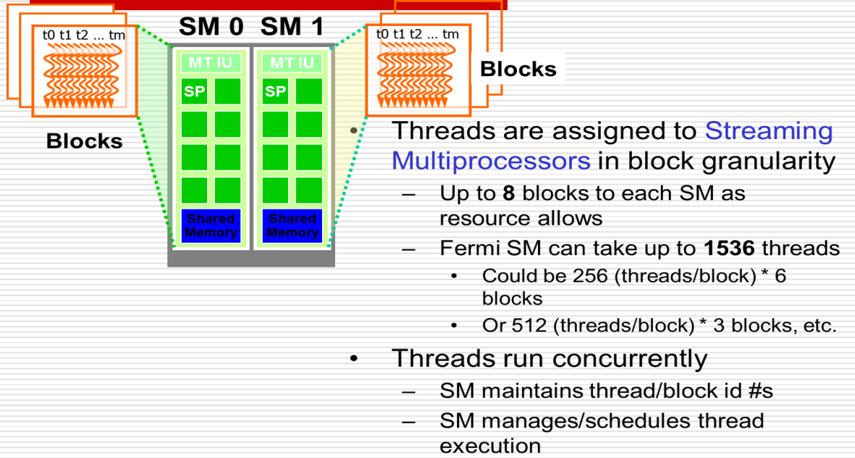
Assigning Resources to Blocks

Slide 7
Thread Scheduling: Warps and Thread Execution
A warp is a group of 32 threads that are executed concurrently on an NVIDIA GPU.
Warps are the basic units of execution and scheduling on NVIDIA GPUs.
Threads within a warp execute in lockstep, meaning they all execute the same instruction simultaneously.

Slide 8
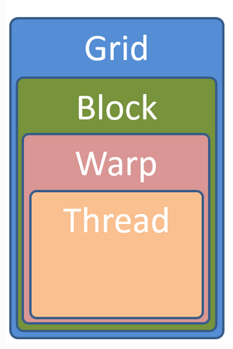
Warps and Thread Execution

Slide 9
Difference Between Warp And Block
Warp
A warp is a group of threads that are executed together in lockstep on the GPU's processing cores.
Warps are the basic units of execution and scheduling on NVIDIA GPUs.
In NVIDIA GPUs, a warp typically consists of 32 threads.
All threads within a warp execute the same instruction at the same time, but they may operate on different data elements.
Block
A block is a grouping of threads that are scheduled together for execution on a streaming multiprocessor (SM) within the GPU.
Threads within a block can cooperate and synchronize via shared memory.
The number of threads per block is limited by the specific GPU architecture and can vary, but it typically ranges from a few dozen to a few thousand threads per block.
Blocks are used to partition the overall computation into manageable units and to exploit parallelism within the GPU.

Slide 10
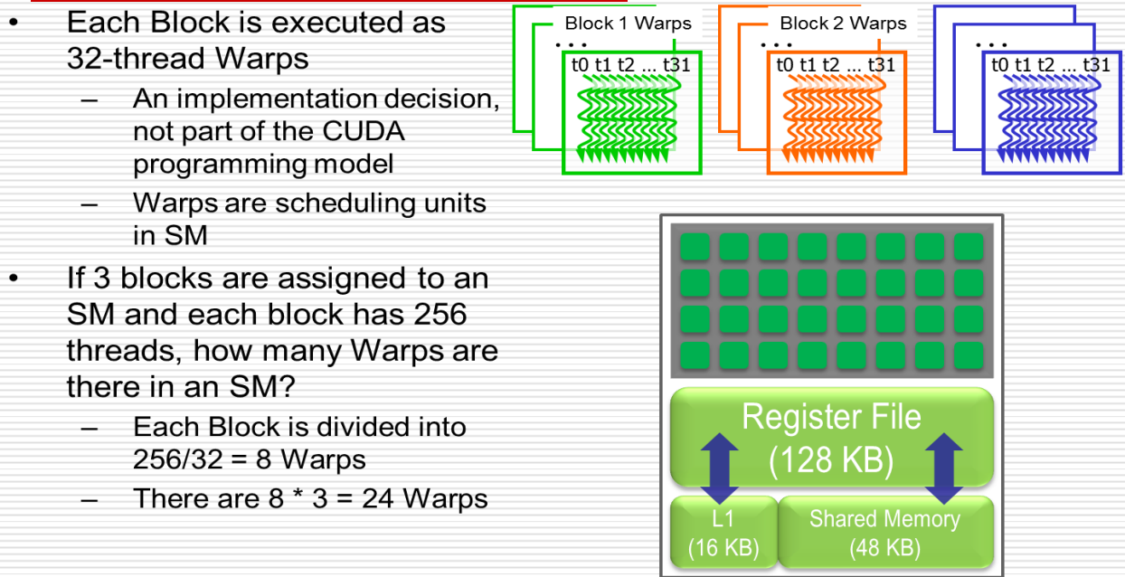
Thread Scheduling

Slide 11
Example
We know that a SM can accommodate up to 1536 threads.
Also, the configuration depends upon the programmer.
This can be in the form of 3 blocks of 512 threads each, 6 blocks of 256 threads each or 12 blocks of 128 threads each.
What will be the number of warps in each case?

Slide 12
Solution
Case 1: 3 blocks of 512 threads each
Threads per block = 512
Warps per block = 512 / 32 = 16
Total warps = 3 × 16 = 48
Case 2: 6 blocks of 256 threads each
Threads per block = 256
Warps per block = 256 / 32 = 8
Total warps = 6 × 8 = 48
Case 3: 12 blocks of 128 threads each
Threads per block = 128
Warps per block = 128 / 32 = 4
Total warps = 12 × 4 = 48
Final Answer:
Each configuration results in 48 warps in total.

Slide 13
Latency Tolerance
It refers to the ability of the CUDA architecture to hide the delays caused by long – latency operations (like memory access) by switching execution between different warps that are ready to run.
A lot of processor time goes waste if while a warp is waiting, another warp is not scheduled.
This method of utilizing in the latency time of operations with work from other warps is called latency tolerance.
That is, when a warp is currently waiting for result from a long-latency operation, such as:
global memory access
floating-point arithmetic
branch instructions
The warp scheduler on the SM will pick another warp that’s ready to execute, therefore avoids idle time.
By having adequate number of warps on the SM, the hardware will likely find a warp to execute at any point in time.

Slide 14
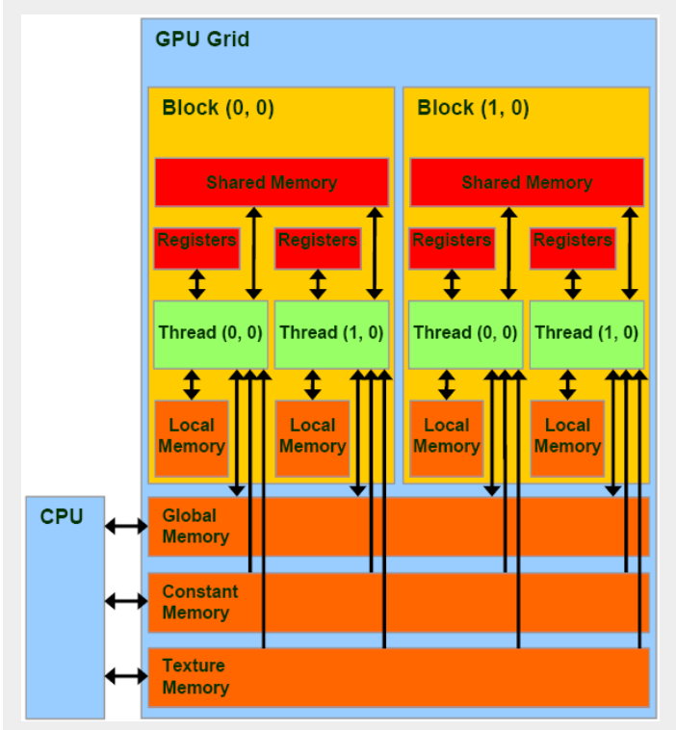
CUDA Memory Model

Slide 15
Components of CUDA Memory Model
Global Memory :
Global memory is the largest memory space available on the GPU.
It is accessible by all threads and persists for the entire duration of the kernel execution.
Global memory is typically used to store input data, output data, and intermediate results.
It has relatively high latency and is optimized for high bandwidth.
Shared Memory :
Shared memory is a fast, low-latency memory space that is shared among threads within the same block.
It is located on-chip, making it much faster to access compared to global memory.
Shared memory is limited in size and is shared among all threads in a block.
It is often used for caching frequently accessed data and for inter-thread communication within a block.

Slide 16
Components of CUDA Memory Model
Local Memory :
Local memory is private to each thread and resides in global memory.
It is used to store local variables and function parameters.
Accessing local memory is slower compared to accessing shared memory because it involves accessing global memory.
Constant Memory :
Constant memory is a read-only memory space optimized for read access.
It is cached and has high access bandwidth.
Constant memory is typically used for storing constants and read-only data that is accessed by all threads.

Slide 17
Components of CUDA Memory Model
Texture Memory :
Texture memory is a specialized read-only memory space optimized for 2D spatial locality.
It supports caching and filtering operations, making it suitable for texture fetching in graphics applications.
Texture memory is often used for applications such as image processing and computer graphics.
Registers :
Registers are small, fast memory spaces located on-chip.
Each thread has its own set of registers for storing temporary variables and calculations.
Accessing registers is extremely fast, but there is a limited number of registers available per thread.

Slide 18
CUDA Device Memory Types Strategy for Reducing Global Memory Traffic
Accessing global memory can be relatively slow compared to on-chip memory like shared memory and registers.
Hence, in CUDA, reducing global memory traffic is essential for optimizing performance.
One strategy for reducing global memory traffic involves utilizing different device memory types efficiently :
By storing data that is repeatedly accessed within a thread block in shared memory, global memory traffic can be reduced.
Utilize constant memory for read-only data that is accessed by multiple threads. Constant memory is suitable for storing constants and read-only data.
Optimize register usage and minimize register spilling to reduce the pressure on register file resources. Register spilling occurs when the number of registers needed by a thread exceeds the available register space, causing excess registers to be spilled into global memory.

Slide 19
Memory as a limited factor to parallelism
While CUDA registers and shared memory can be extremely effective in reducing the number of accesses to global memory, one must be careful to stay within the capacity of these memories.
These memories are forms of resources necessary for thread execution.
Each CUDA device offers limited resources, thereby limiting the number of threads that can simultaneously reside in the SM for a given application.
In general, the more resources each thread requires, the fewer the threads that can reside in each SM, and likewise, the fewer the threads that can run in parallel in the entire device.

Slide 20
Performance Considerations
If we can reduce the number of memory fetches per iteration, then the performance will certainly go up.
Dynamic partitioning of resources
Acceleration with GPU
Streaming multiprocessor resources
Data prefetching and instruction mix
Maximizing instruction output
Registers between global and shared memory

Slide 21
Dynamic partitioning of resources
Registers hold frequently used programmer and compiler-generated variables to reduce access latency and conserve memory bandwidth.
Variables in a kernel that are not arrays are automatically placed into registers.
By dynamically partitioning the registers among blocks, a streaming multiprocessor can accommodate :
more blocks if they require few registers, and
fewer blocks if they require many registers

Slide 22
Acceleration with GPU
Blocks of threads are launched by the Central Processing Unit (CPU), called the host, and the device (GPU) accelerates the computations.
In each kernel launch, we must configure the dimensions of the grid and the number of threads in each block in the grid.
Using too many registers in a block can lead to a performance issues.

Slide 23
Streaming multiprocessor resources
During runtime, thread slots are partitioned and assigned to thread blocks.
Streaming multiprocessors are versatile by their ability to dynamically partition the thread slots among thread blocks.
Streaming multiprocessors can
either execute many thread blocks of few threads each.
or execute a few thread blocks of many threads each.
In contrast, fixed partitioning where the number of blocks and threads per block are fixed will lead to wastage.
Number of thread slots = warp size × number of warps per block

Slide 24
Example -Tesla C2050
The Tesla C2050 has 6 SM's and 1536 thread slots per streaming multiprocessor. Calculate the number of warps per block. Also calculate the total number of warps in Tesla C2050.
Number of thread slots = warp size × number of warps per block
Warp size = 32 threads per block
1536= 32 x number of warps per block
Number of warps per block= 1536/32 = 48 warps
Consider only one block per SM
Therefore 48 warps per SM
Total number of warps in Tesla C2050 = 48*6= 288 warps

Slide 25
End of Module 5
(THANK YOU)

